Slide 1
Docker
with
run:ai
(and Jupyter)

Slide 2
Docker intro

Slide 3
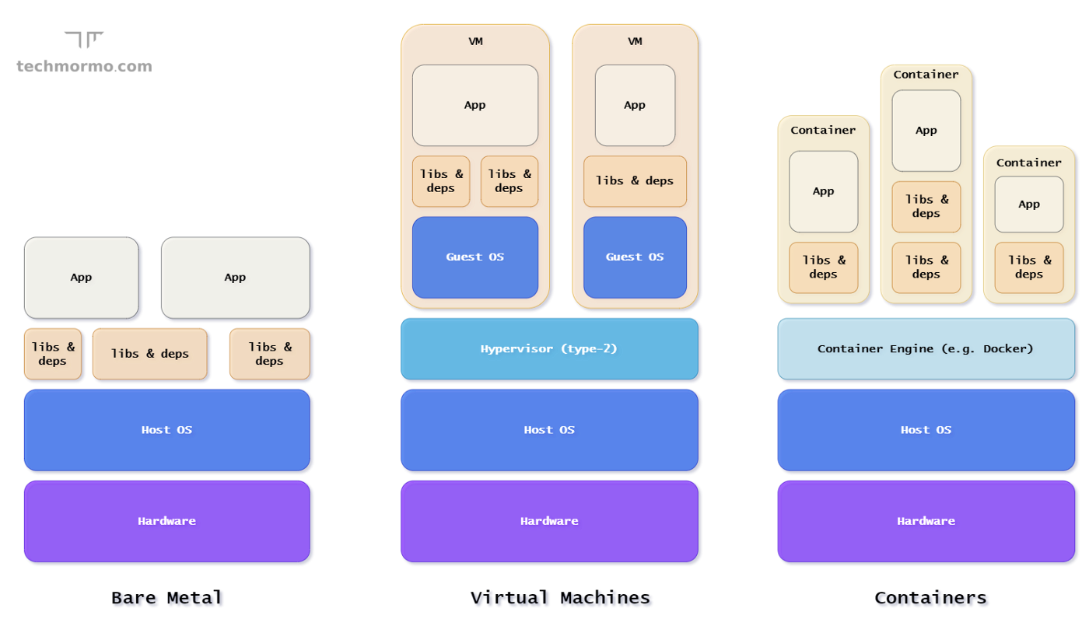
What is Docker?
Docker is a way to create “images.”
Image have an OS (usually linux) and software installed on them
Images can be run on any hardware as “containers”

Slide 4

Why use Docker?
… and simply run the image inside a container on any hardware with docker engine running.
User 1 Code
User 2 Code
User 3 Code
Requires
Cudatoolkit=11.2
Python=3.7
Requires
Cudatoolkit=11.7
Python=3.9
Requires
Cudatoolkit=11.5
Python=3.8
Image 1
Image 2
Image 3
Image 1
Image 2
Image 3
Each user can create an image with the software they need installed on it…
User 1 Code
User 2 Code
User 3 Code

Slide 5

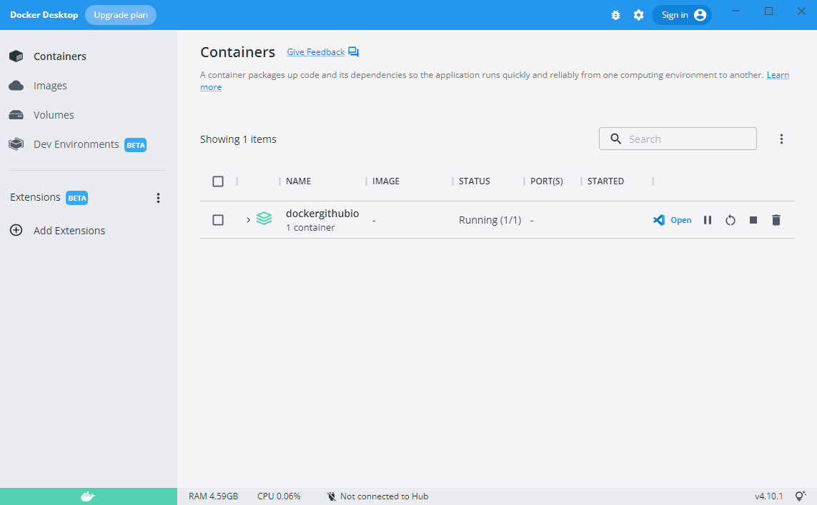
What do I need to use docker?
An image repository
Docker software
I use Docker hub.
I use Docker Desktop.
https://docs.docker.com/desktop/install/linux-install/

Slide 6
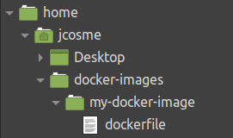
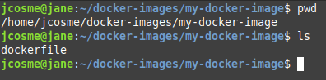
How do I make a Docker image?
1. Make sure Docker desktop is running
2. You’ll need a dedicated folder for your image
3. You’ll need a file called “dockerfile” inside the folder
4. Navigate to the dedicated image folder in a terminal
5. Make sure the dockerfile is in the folder
6. Run this command to build
docker build -t {your-docker-hub-username}/{your-image-name}:{version-number} .
(this is what my command be)
docker build -t jonathancosme/my-docker-image:1.0 .
7. Run this to push to the repo
docker image push {your-docker-hub-username}/{your-image-name}:{version-number}
(this is what my command be)
docker image push jonathancosme/my-docker-image:1.0

Slide 7
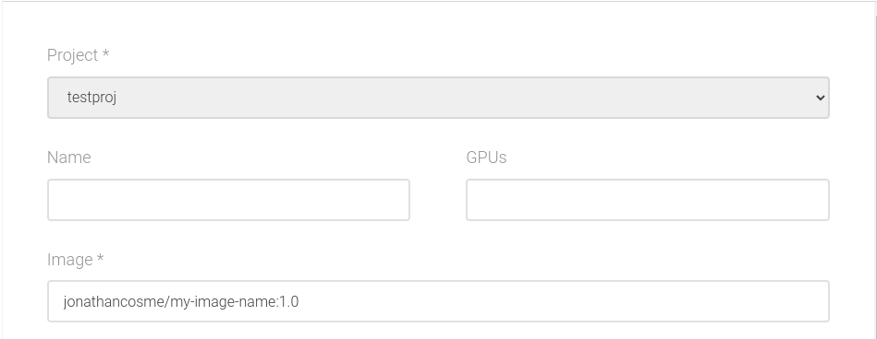
How I use my Docker image with run:ai?
Enter the image name in the Image field of the UI
Use the -i flag on the CLI to specify the image
runai submit -i jonathancosme/my-image-name:1.0 {other arguments}

Slide 8
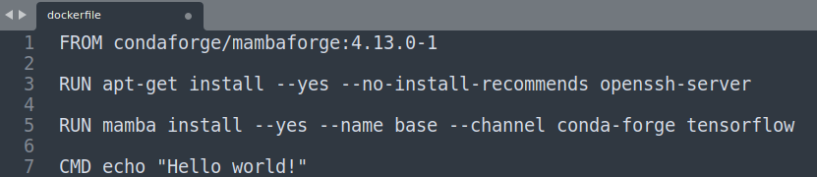
What is a “dockerfile?”
A “dockerfile” is a simple text file that tells docker how to build your image.
There are 3 basic commands to use
FROM - specifies the base image to use (a starting point)
RUN - specifies a command to run in a terminal. This is used to install software.
CMD - specified the default command for the image to run, if no command is specified.
(yes, these are case-sensitive, and must always be in caps)
A full list and explanation of the dockerfile commands can be found here:
https://docs.docker.com/engine/reference/builder/

Slide 9
What is a “dockerfile?”
In this particular image,
1. We start with an image with conda and mamba preinstalled
2. Install openssh-server
4. Tell the image to print “Hello world!” if no command is given
3. Use mamba (version of conda written in C++, so it’s much faster) to install tensorflow

Slide 10
About “layers”
Every time a dockerfile command is used, a “layer” is created
This image has at least 4 layers.
Keep in mind that the base image (FROM command) also has layers, so our layers will be built on top of these.
Essentially, we will have number-of-layers-in-base-image + 3 layers.

Slide 11


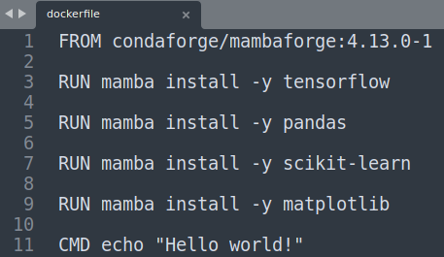
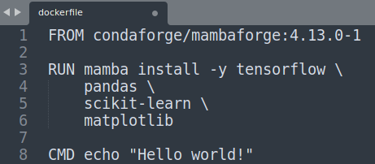
About “layers”
All else equal, more layers make the image larger.
As a general rule, we want images to be small.
Pay attention to how you create your layers
When you create a layer, it should accomplish a specific task, rather than installing one software package

Slide 12
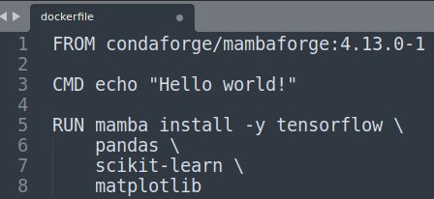
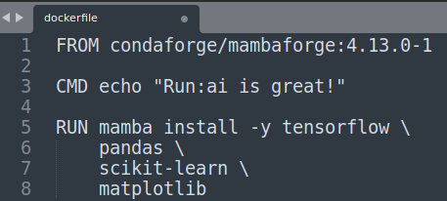
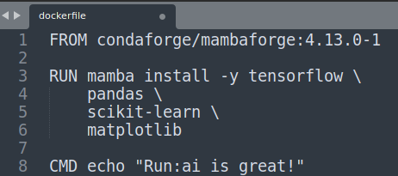
About “layers”
When building images, docker will “cache” layers that have not changed; this makes building faster.
If a layer is changed, all layers after it will need to be re-built.
You want to structure your layers so that the most-often change layers are at bottom
Original
Change
Rebuild layers

Slide 13
Docker images with Run:ai
(using Jupyter example)

Slide 14







Key concepts
1. Think of your software and your storage as separate
2. Run:ai will take care of the hardware
3. Your software will be put in containers (via Docker)
4. Your code and data will be kept on the NFS

Slide 15
Key concepts
The idea is that you will mount your NFS, then run a script that is stored on the NFS

Slide 16
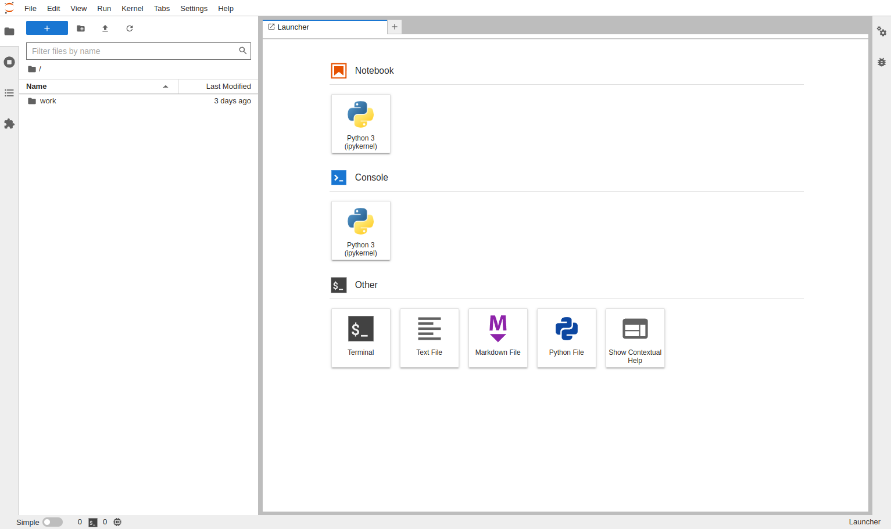
Jupyter
Jupyter Lab is a tool commonly used by data scientist.
For our example, we will use an official image which can be pulled with:
jupyter/base-notebook

Slide 17
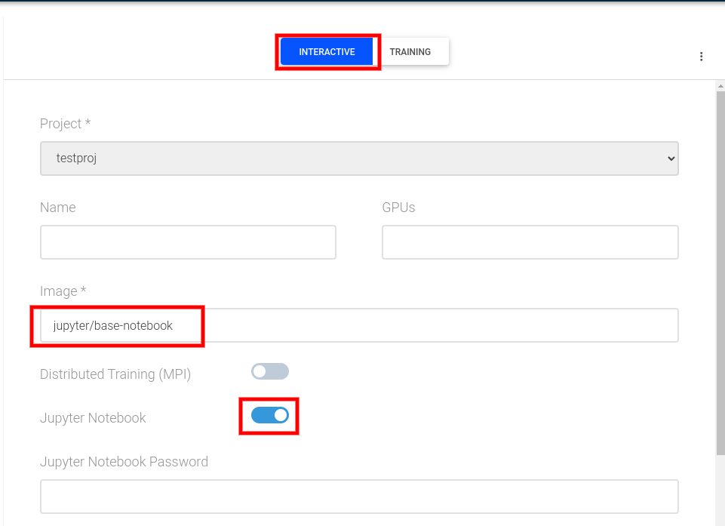
Jupyter on Run:ai
On the New Job UI:
Select Interactive
Specify Image as jupyter/base-notebook
Toggle the Jupyter Notebook option
Submit the job

Slide 18
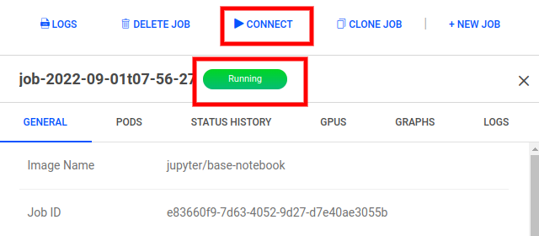
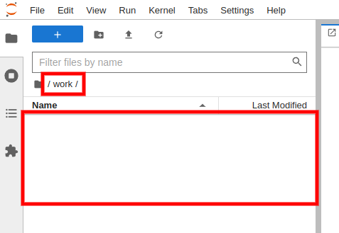
Jupyter on Run:ai
After the job status changes to Running, you can connect to the Jupyter Lab UI.
If you navigate to the work folder, you’ll notice it’s empty.

Slide 19
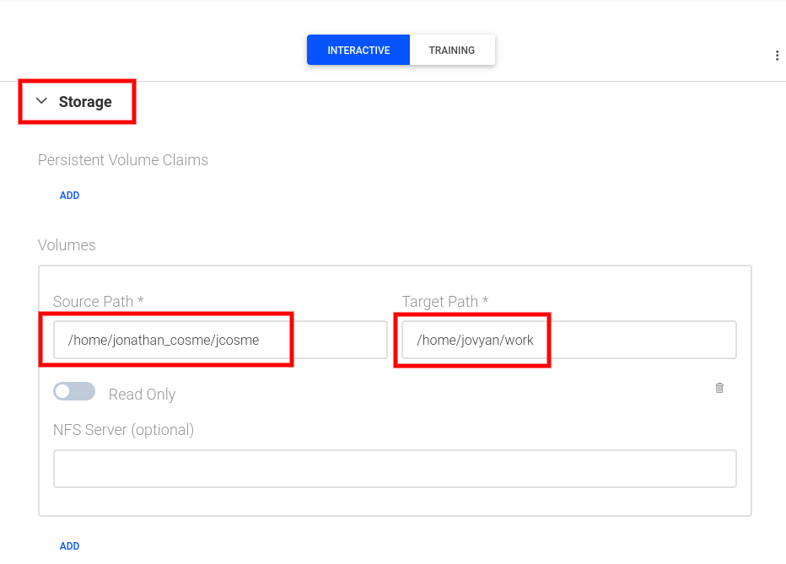
Jupyter on Run:ai with mounted NFS
We’ll start with the same options as before…
… but this time, we’ll mount our NFS folder to the “work” directory.
On the New Job UI:
Select Interactive
Specify Image as jupyter/base-notebook
Toggle the Jupyter Notebook option
Under Storage, select Add volume
Input your NFS directory into the Source Path
Input /home/jovyan/work into the Target Path

Slide 20
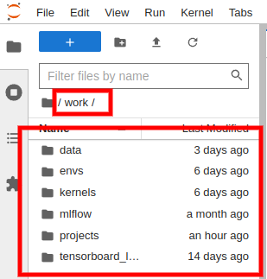
Jupyter on Run:ai with mounted NFS
After the job status changes to Running, you can connect to the Jupyter Lab UI.
If you navigate to the work folder, you’ll notice that all our files and folder are there

Slide 21
Docker with non-interactive jobs

Slide 22
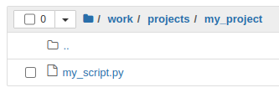
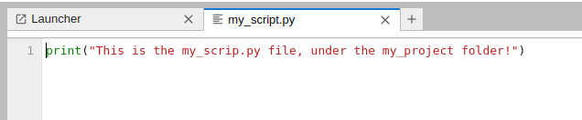
Running a non-interactive job
Lets say that I had a script called my_script.py
This is the content of the python script:

Slide 23
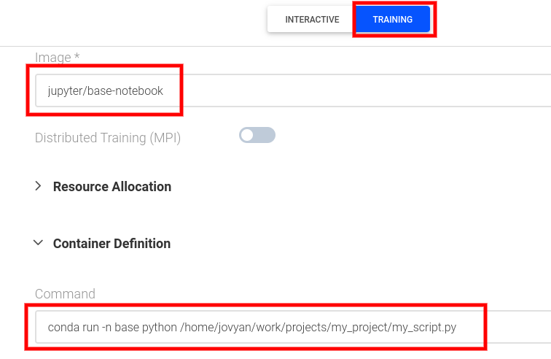
Running a non-interactive job
In order to run the script using the image:
Select Training type job
Specify the image as jupyter/base-notebook
Mount your NFS volume
Add a Command under Container Definition
In Command, under Container Definition, input: conda run -n base python /home/jovyan/work/projects/my_project/my_script.py
1
2
3
4

Slide 24
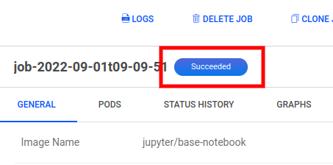
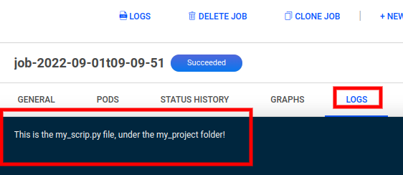
Running a non-interactive job
Wait for the job status to change to Succeeded
In the Logs tab, you should see the output of my_script.py

Slide 25
Closing notes

Slide 26
Closing notes
Some general Docker tips
Use an official Docker image as a base image
- They are more stable
Use a specific version (the more specific the better)
- If no version is specified Docker will just take the latest version, which could break your image
If starting with a raw OS image, selected an image with a lean distribution.
- For example, use Alpine over Ubuntu. Ubuntu contains a lot of software you won’t need.
BE AWARE
ONLY THE CONTENT OF THE FOLDER CONTAINING YOUR NFS MOUNT WILL BE SAVED/PERSIST
- This means that ALL OTHER FILES that were created during the job session will be gone forever, once the job finishes
ANY SOFTWARE CHANGES (using apt/apt-get install or conda/mamba install/create) made while the job is running WILL NOT BE SAVED
- If you want to make permanent software changes to the image, you will need to update the dockerfile, re-build it, and re-push it to Docker hub.

Slide 27
Thank you!

